Slide 1
Workshop 4

Slide 2
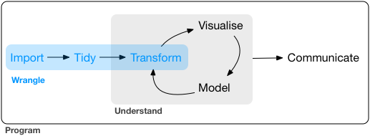

Slide 3
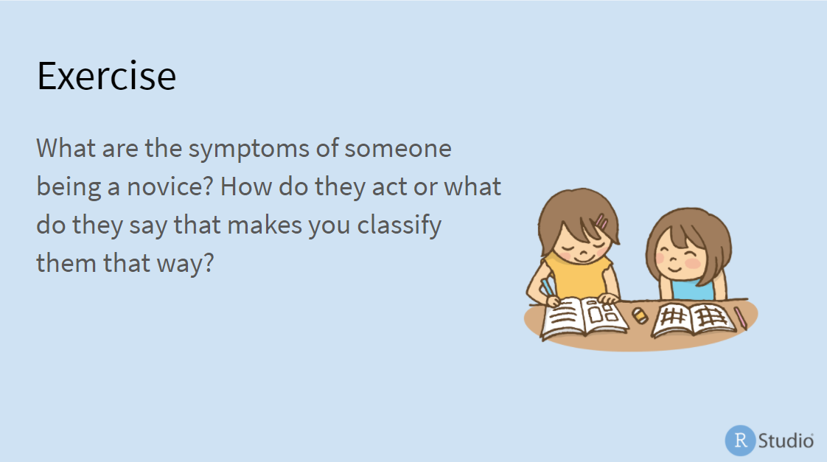

Slide 4
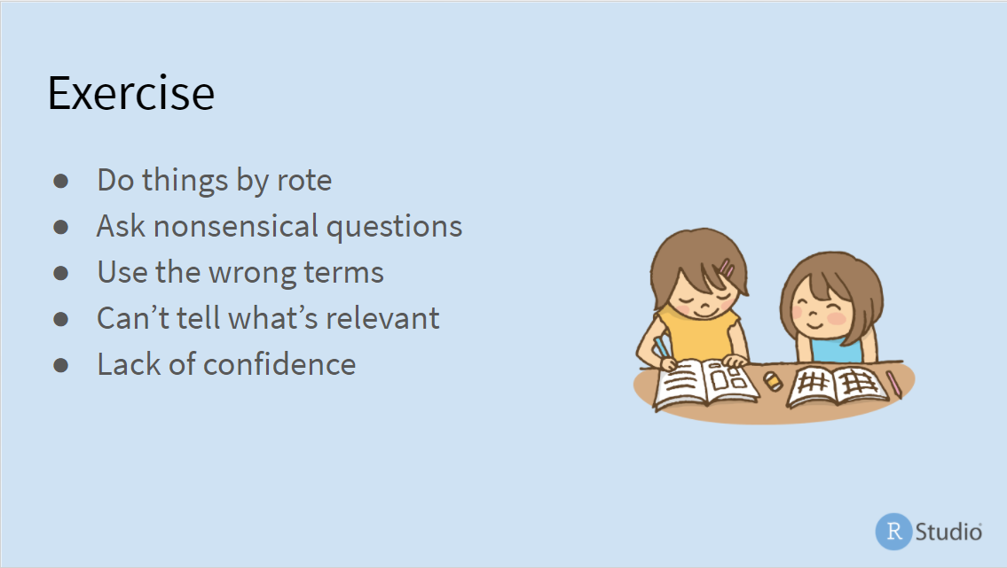

Slide 5

No mental model of the problem:
What are the important pieces?
How do they relate.
-> follow steps without understanding why
-> borrow concepts from other domains they understand and hope

Slide 6
No mental model of the problem:
What are the important pieces?
How do they relate.

Slide 7
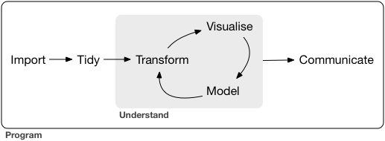
Workflow

Slide 8
Where should you be by end of workshops?
Do things by rote?
Going piece by piece, so you understand

Slide 9
Where should you be by end of workshops?
Do things by rote?
Going piece by piece, so you understand
Use the wrong terms?
Learn some lingo

Slide 10
Where should you be by end of workshops?
Do things by rote?
Going piece by piece, so you understand
Use the wrong terms?
Learn some lingo
Can’t tell what is relevant?
Search stackoverflow with a “tidyverse” filter

Slide 11
Where should you be by end of workshops?
Do things by rote?
Going piece by piece, so you understand
Use the wrong terms?
Learn some lingo
Can’t tell what is relevant?
Search stackoverflow with a “tidyverse” filter
Ask nonsensical questions?
learn to structure questions and make a reprex

Slide 12
Where should you be by end of workshops?
Do things by rote?
Going piece by piece, so you understand
Use the wrong terms?
Learn some lingo
Can’t tell what is relevant?
Search stackoverflow with a “tidyverse” filter
Ask nonsensical questions?
learn to structure questions and make a reprex
Congratulations – You are now an intermediate user!

